Slide 1
Dining philosopher

Slide 2
Dining Philosophers
A problem that was invented to illustrate a different aspect of communication
Our focus here is on the notion of sharing resources that only one user at a time can own
Such as a keyboard on a machine with many processes active at the same time
Or a special disk file that only one can write at a time (bounded buffer is an instance)

Slide 3
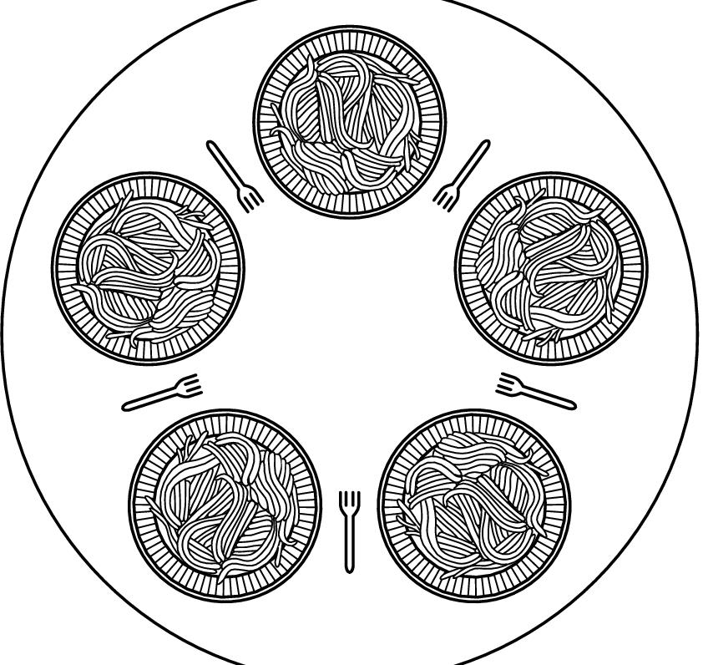
Dining Philosopher’s Problem
Dijkstra
Philosophers eat/think
Eating needs two forks
Pick one fork at a time
Idea is to capture the concept of multiple processes competing for limited resources

Slide 4
The dining philosophers problem is speciﬁed as follows.
• Five philosophers live in a house, where a round table is laid for them to eat (see the ﬁgure below).
• Each philosopher has an assigned place at the table.
• The life of each philosopher consists of alternating between thinking and eating.
• Each philosopher requires two forks to eat.
• On the round table, there are 5 plates, one for each philosopher, and 5 forks between the plates (see the ﬁgure below).
• A philosopher wishing to eat goes to his assigned place at the table, picks up the two forks on the either side of the plate, and eats. When the philosopher is done, he lays down the two forks that he used for eating.
Since two philosophers who sit in adjacent seats share a fork, and since multiple philosophers can eat at the same time, we need an algorithm to synchronize how the philosophers use their forks. Our synchronization algorithm must allow a philosopher to pick up two forks simultaneously, so that the philosophers can eat. The algorithm must ensure that each fork is used by at most one philosopher at any one time (mutual exclusion). The algorithm must also avoid starvation and deadlock.

Slide 5
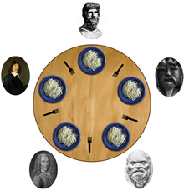

Slide 6
FIRST TRY
All the philosophers pick their right fork simultaneously

Slide 7
#define N5
Void philosopher (int i){
While (TRUE) {
think( ); //for sometime
take _fork(R);
take_fork(L);
eat();
Put _fork(L);
Put _fork(R);
}
}

Slide 8
Suppose p1 andp3 have highest priority . P2 , p4, and p5 have lowest priority . They can starve .
If all the philosophers can pick up their right fork only . This could leave a starvation. Leading starvation we call it deadlock . Circular waits also leads to starvation.

Slide 9
Second Try
All philosophers start at the same time.
Run simultaneously .
This could lead to deadlock because philosophers taking fork and putting it down continuously .

Slide 10
Second Try
#define N5
Void philosopher (int i){
While(true) {
Think( );
take_fork( R);
If(available(L){
take-fork(L);
eat();
put_fork(R );
put_fork(L);
}
else
{put _fork(R);
sleep(T);
}
}

Slide 11
Solution using MUTEX
Protect critical sections with a mutex.
Prevents deadlock
But has performance issues
only one philosopher can eat at a time.

Slide 12
#define N5
Void philosopher ( ){
While(TRUE){
Think( );// for some_time
lock(mutex);
take _fork(R);
take_fork(L);
Eat();
Put_fork(L);
Put_fork( R);
Unlock(mutex);
}
}

Slide 13
Solution with N semaphores

Slide 14
This solution has the following characteristics.
The ﬁve philosopher are numbered 0 to 4.
Each philosopher is represented by a thread that executes the function philosopher(i), where i is the number of that philosopher.
A philosopher can be in one of three predeﬁned states: HUNGRY (waiting for a fork), EATING (has 2 forks and is eating), or THINKING.
The solution uses a shared array state and a semaphore mutex to ensure mutual exclusion in accessing this array.
The solution also uses an array of semaphores s.
There are predeﬁned functions for thinking and eating that can take any amount of time to complete.

Slide 15
// Global variables. Shared among threads.
int state[5]; // Initially state[i]==THINKING for all i.
semaphore mutex; // Initially set to 1.
semaphore s[5]; // Initially s[i] is set to 0 for all i.

Slide 16
void philosopher(int i)
{ while(TRUE)
{
think();
take forks(i);
eat();
put forks(i); }
}

Slide 17
void take forks(int i)
{ P(mutex);
state[i] = HUNGRY;
test(i);
V(mutex);
P(s[i]);
}

Slide 18
void put forks(int i)
{
P(mutex);
state[i] = THINKING;
test(left(i));
test(right(i));
V(mutex);
}

Slide 19
int left(int i)
{
//philosopher to the left of i.
// % is the mod operator.
Return(i+4)%5;
}
Int right(int i){
//philosopher to the right of i.
return(i+1)%5;
}
Void test (int i){
If (state[i]==HUNGRY && state[left(i)]!=EATING && state[right(i)]!=EATING){ state[i]=EATING; V(s[i]);
}
}

Slide 20
Role of semaphore s[i] in solution
Semaphore s[i] is assigned to philosopher i. The role of this semaphore is to enable philosopher i to eat only when the conditions for eating are satisﬁed. Semaphore s[i] is set to 1, thereby enabling philosopher i to eat, only when philosopher i wants to eat and both forks are available.

Slide 21
Role of test(i)
This function has two roles:
Philosopher i calls test(i) (in take forks()) to check whether the left and right forks are available.
If both forks are available (the left and right philosophers are not eating), then V(s[i]) will be called and the call to P(s[i]) in take forks() will not block. So philosopher i will be able to call eat().
If the left or right fork is unavailable (the corresponding philosopher is eating), then test(i) does not call V(s[i]) and, hence, the call to P(s[i]) in take _forks() blocks philosopher i.
Philosopher i also calls test(left(i)) and test(right(i)) when he is done eating to unblock the philosophers to his left and right if they are waiting to eat and can now eat.

Slide 22
Starvation
1. Philosopher 1 starts eating.
2. Philosopher 3 starts eating.
3. Philosopher 2 wants to eat, calls take forks(2), and gets blocked.
4. Philosopher 1 ﬁnishes eating but cannot call V(s[2]) to unblock philosopher 2 because philosopher 3 is still eating.
5. Philosopher 1 starts eating again.
6. Philosopher 3 ﬁnishes eating but cannot call V(s[2]) to unblock philosopher 2 because philosopher 1 is still eating.
7. Philosopher 3 starts eating again.
8. Goto Step 4.
This way, philosopher 2 never gets a chance to eat.

Slide 23
Dining Philosophers and the Deadlock Concept

Slide 24
Rules of the Game
The philosophers are very logical
They want to settle on a shared policy that all can apply concurrently
They are hungry: the policy should let everyone eat (eventually)
They are utterly dedicated to the proposition of equality: the policy should be totally fair

Slide 25
What can go wrong?
Primarily, we worry about:
Starvation: A policy that can leave some philosopher hungry in some situation (even one where the others collaborate)
Deadlock: A policy that leaves all the philosophers “stuck”, so that nobody can do anything at all
Livelock: A policy that makes them all do something endlessly without ever eating!

Slide 26
Starvation vs Deadlock
Starvation vs. Deadlock
Starvation: thread waits indefinitely
Example, low-priority thread waiting for resources constantly in use by high-priority threads
Deadlock: circular waiting for resources
Thread A owns Res 1 and is waiting for Res 2 Thread B owns Res 2 and is waiting for Res 1
Deadlock ⇒ Starvation but not vice versa
Starvation can end (but doesn’t have to)
Deadlock can’t end without external intervention
Thread
A
Wait
For
Owned
By
Res 1
Res 2
Owned
By
Wait
For
Thread
B

Slide 27
A flawed conceptual solution
# define N 5
Philosopher i (0, 1, .. 4)
do {
think();
take_fork(i);
take_fork((i+1)%N);
eat(); /* yummy */
put_fork(i);
put_fork((i+1)%N);
} while (true);

Slide 28
Coding our flawed solution?
Shared: semaphore fork[5];
Init: fork[i] = 1 for all i=0 .. 4
Philosopher i
do {
P(fork[i]);
P(fork[i+1]);
/* eat */
V(fork[i]);
V(fork[i+1]);
/* think */
} while(true);
Oops! Subject to deadlock if they all pick up their “right” fork simultaneously!

Slide 29
Dining Philosophers Solutions
Allow only 4 philosophers to sit simultaneously
Asymmetric solution
Odd philosopher picks left fork followed by right
Even philosopher does vice versa
Pass a token
Allow philosopher to pick fork only if both available

Slide 30
One Possible Solution
Introduce state variable
enum {thinking, hungry, eating}
Philosopher i can set the variable state[i] only if neighbors not eating
(state[(i+4)%5] != eating) and (state[(i+1)%5]!= eating
Also, need to declare semaphore self, where philosopher i can delay itself.

Slide 31
One possible solution
Shared: int state[5], semaphore s[5], semaphore mutex;
Init: mutex = 1; s[i] = 0 for all i=0 .. 4
take_fork(i) {
P(mutex);
state[i] = hungry;
test(i);
V(mutex);
P(s[i]);
}
put_fork(i) {
P(mutex);
state[i] = thinking;
test((i+1)%N);
test((i-1+N)%N);
V(mutex);
}
Philosopher i
do {
take_fork(i);
/* eat */
put_fork(i);
/* think */
} while(true);
test(i) {
if(state[i] == hungry
&& state[(i+1)%N] != eating
&& state[(i-1+N)%N != eating)
{
state[i] = eating;
V(s[i]);
}

Slide 32
Solutions are less interesting than the problem itself!
In fact the problem statement is why people like to talk about this problem!
Rather than solving Dining Philosophers, we should use it to understand properties of solutions that work and of solutions that can fail!

